Slide 1
Discrete Mathematics BCSC 0010
Module 2 Validity of Arguments
(By Resolution Principle)

Slide 2
Resolution Principle
Literal: A variable or negation of a variable
Clause : Disjunction of literals
Resolution rule of inference is based on the tautology
The final disjunction in the resolution rule, q v r, is called the resolvent.

Slide 3
Argument validity by Resolution Principle
Consider an argument where p1,p2,….,pn are premises and C is the conclusion.
To prove the validity of the argument by resolution principle,
Put p1,p2…,pn in clause form and add to it ~C in clause form
From this sequence if (empty clause ) can be derived , the argument is valid

Slide 4
Example
Consider Modus Ponens
Validity Proof:
Hence the argument is valid

Slide 5
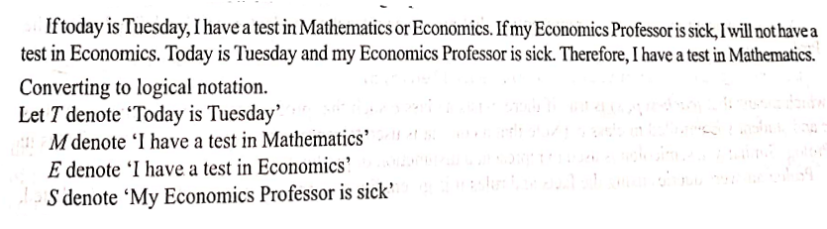
Example
contd..

Slide 6
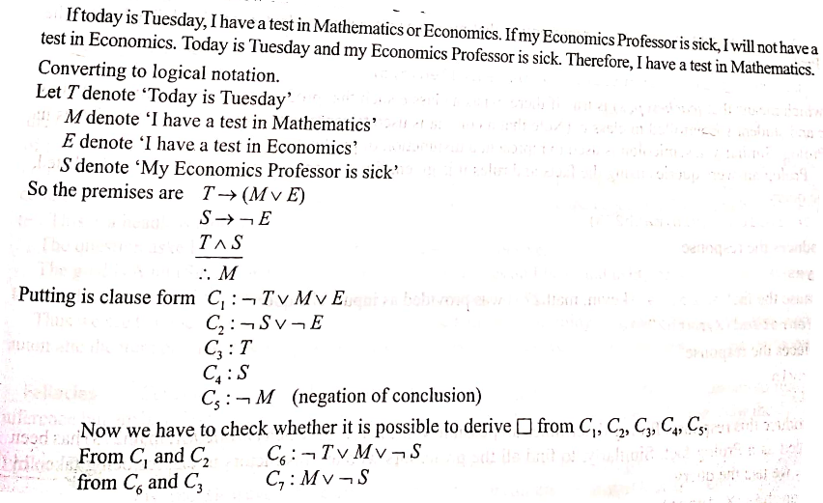
contd..

Slide 7
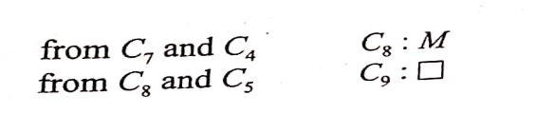
Hence the argument is valid

